Slide 1
Basic Computer Science

Slide 2
Software Development Models

Slide 3
Software Development
A set of activities for specifying, designing, implementing and testing software systems.
A set of activities and associated outcome that produce a software product.
Software engineers mostly carry out these activities.
These are four key process activities, which are common to all software processes.
These activities are:
Software
Specification
Development
Validation
Evolution

Slide 4
Software Development Model
One of the basic notions of the software development process is SDLC model.
SDLC is a pictorial and diagrammatic representation of the software life cycle.
The models specify the various stages of the process in which they are carried out.
There is no one single SDLC model.
They are divided into main groups, each with its features and weaknesses.

Slide 5
Software Development Model
The most used, popular and important SDLC models are given below:
Waterfall Model
Agile Model
Iterative Model
V Model
Incremental Model
RAD Model
Spiral Model

Slide 6
Waterfall Model
The waterfall is a cascade SDLC model that includes gradual executions of phases.
The waterfall model is a breakdown of project activities into linear sequential phases.
Each phase depends on the deliverables of the previous phase.
The approach is typical for certain areas of engineering design.
This process is documented and predefined with features expected to every phase.

Slide 7
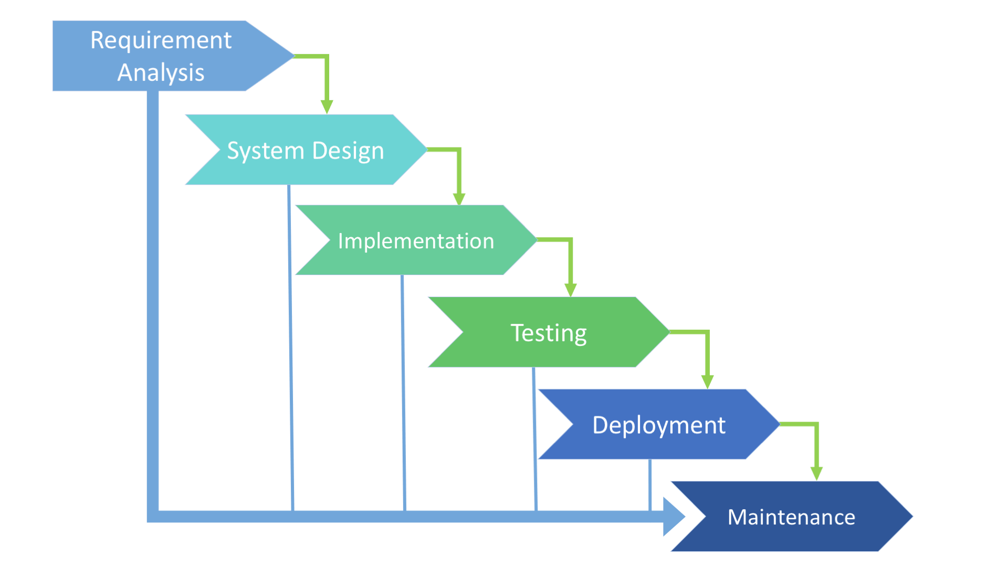
Waterfall Model

Slide 8
V Model
V-shaped SDLC model is an expansion of classic waterfall model.
This model is based on associated test stage for every development stage.
This is a very strict model, and the next stage is started only after the previous phase.
This is also called “Validation and verification” model.
The horizontal axes represent time or project completeness (left-to-right).
The vertical axes represent level of abstraction (coarsest-grain abstraction uppermost).

Slide 9
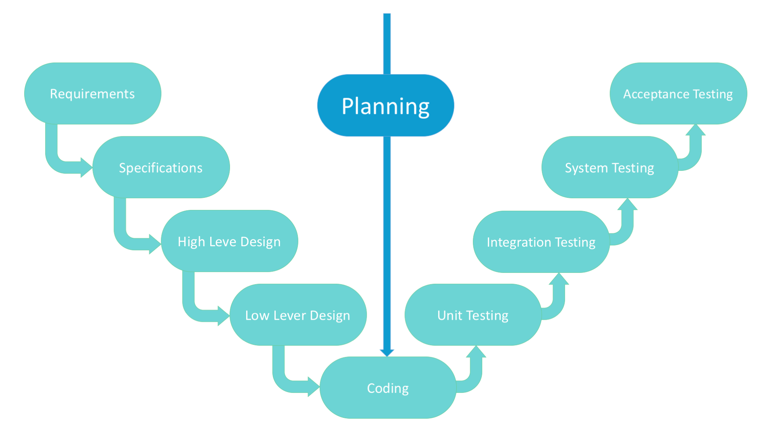
V Model

Slide 10
Incremental Model
This model is done in steps from analysis, implementation, testing and maintenance.
Each iteration passes through the requirements, design, coding and testing phases.
It involves both development and maintenance.
The product is defined as finished when it satisfies all its requirements.
This model combines the elements of the waterfall with the iterative of prototyping.
The system is put into production when the first increment is delivered.
System development is broken down into many mini development projects.
Highest priority requirement is tackled first.

Slide 11
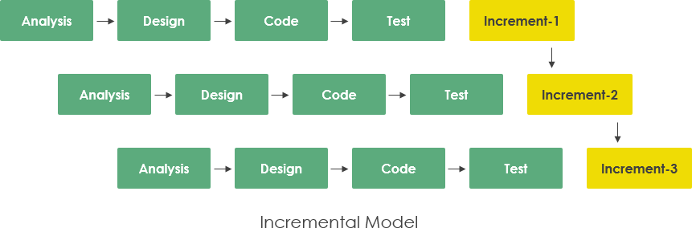
Incremental Model

Slide 12
RAD Model
Rapid application development is often referred as the adaptive software development.
RAD is an incremental prototyping approach to software development.
Here, end users can produce better feedback when examining a live system.
It puts less emphasis on planning and more emphasis on an adaptive process.
RAD is a concept that products can be developed faster and of higher quality through:
Gathering requirements using workshops or focus groups.
Prototyping and early, reiterative user testing of designs.
The re-use of software components.
Less formality in reviews and other team communication.

Slide 13
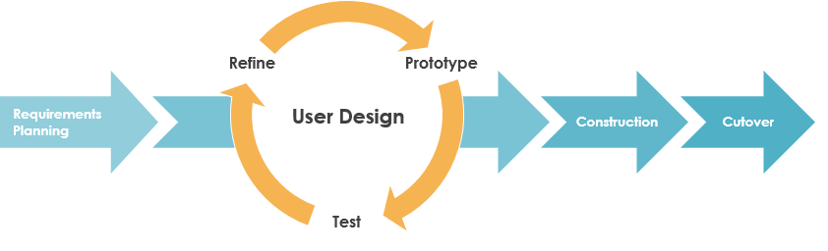
RAD Model

Slide 14
Agile Model
In the agile methodology after every development iteration, the customer is able to see the result and understand if he is satisfied with it or is not.
Extreme programming is one of the practical use of the agile model.
The Agile movement proposes alternatives to traditional project management.
Agile software development approach is typically operated in rapid and small cycles.
This results in more frequent incremental releases with each release.
Thorough testing is done to ensure that software quality is maintained.
Organizations can be agile using many of the available frameworks available such as Scrum, Kanban, Lean, Extreme Programming (XP) etc.

Slide 15
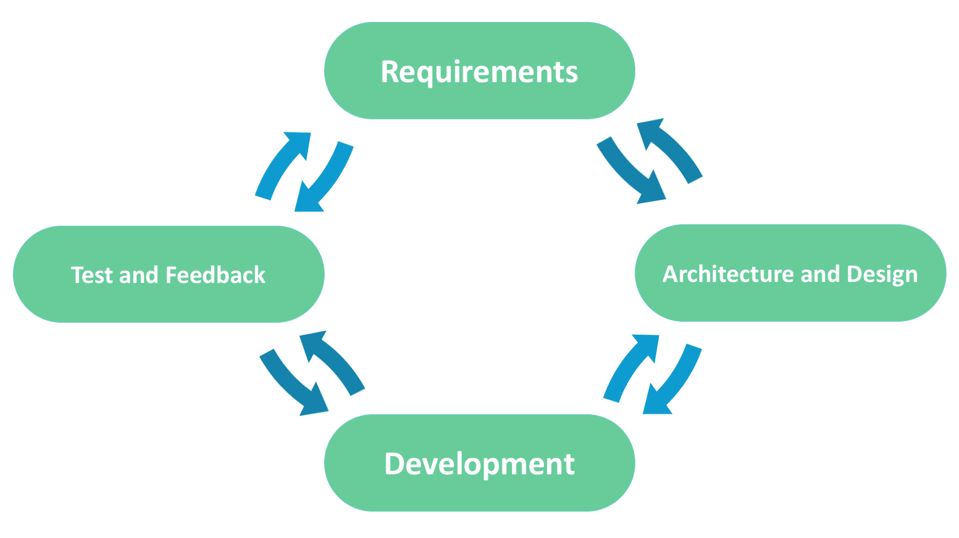
Agile Model

Slide 16
Iterative Model
The Iterative model does not need the full list of requirements before the project starts.
The development process may start with the requirements to the functional part.
The process is repetitive, allowing to make new versions of the product for every cycle.
Every iteration includes the development of a separate component of the system.
And after that, this component is added to the functional developed earlier.
However, in an iterative project a formal software specification may also be required.

Slide 17
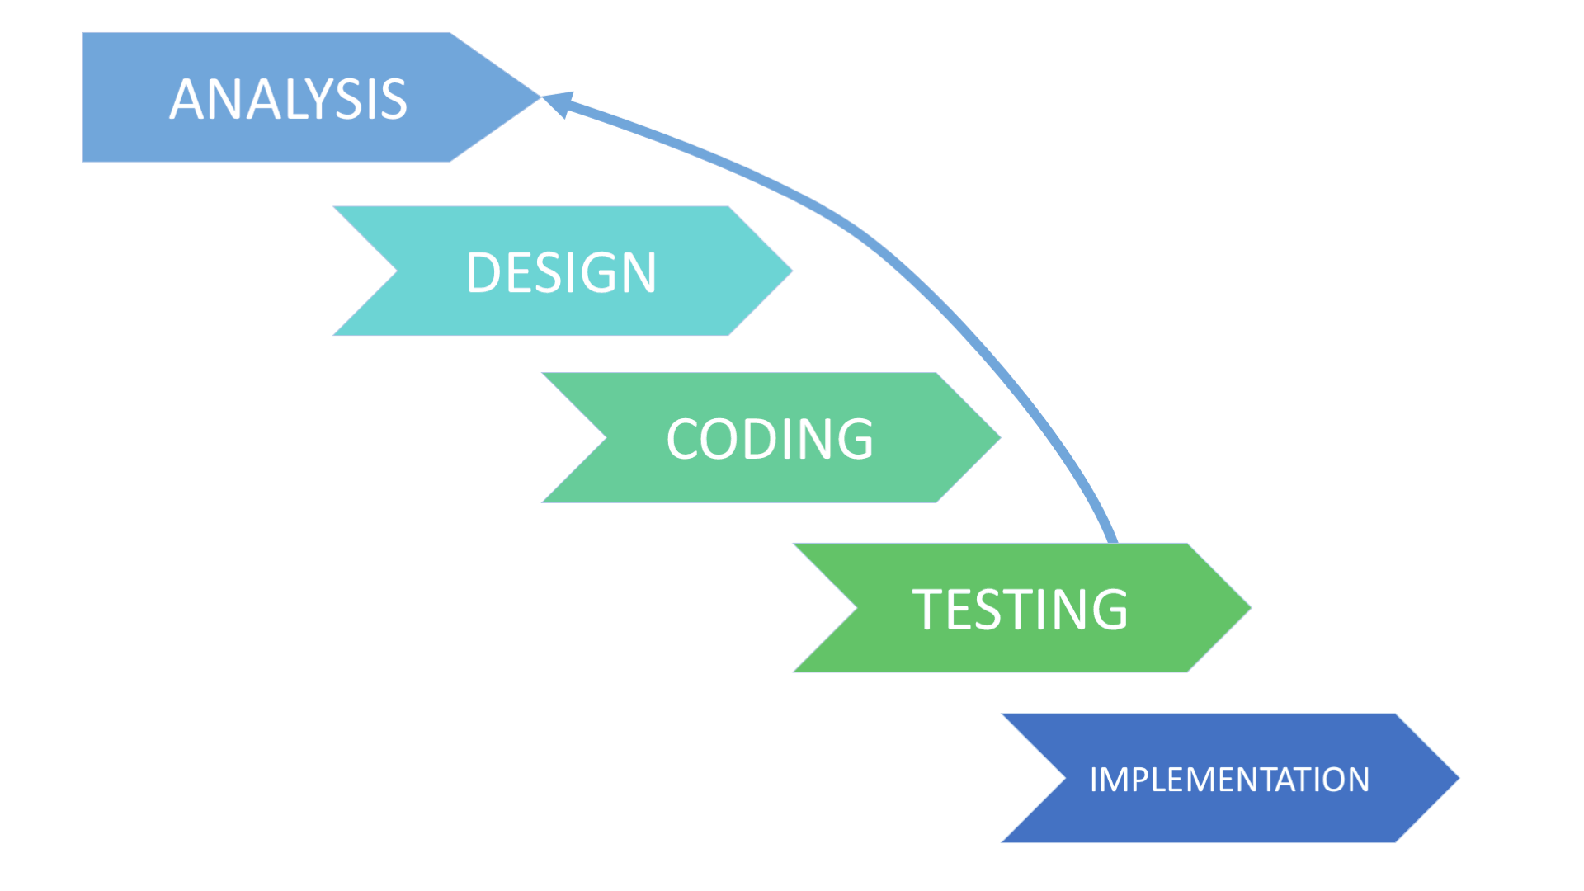
Iterative Model

Slide 18
Spiral Model
Spiral model – is SDLC model, which combines architecture and prototyping by stages.
It is a combination of the Iterative and Waterfall SDLC models with the significant accent on the risk analysis.
In this model, It needs to define right moment to make a step into the next stage.
The preliminary set time frames are recommended as the solution to this issue.
The shift to the next stage is done according to the plan.
Even if the work on the previous stage isn’t done yet.
The plan is introduced basing on the statistic data, received during the previous projects.

Slide 19
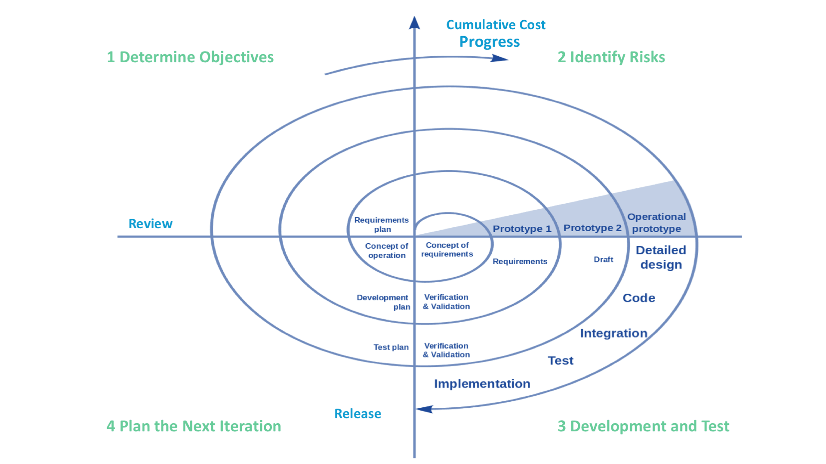
Spiral Model

Slide 20
Software Evolution

Slide 21
Software Evolution
The process of developing a software product using software engineering principles and methods is referred to as software evolution or s/w engineering paradigm.
This includes the initial development of software and its maintenance and updates, till desired software product is developed, which satisfies the expected requirements.
Evolution starts from the requirement gathering process. After which developers create a prototype of the intended software and show it to the users to get their feedback at the early stage of software product development.

Slide 22
Software Evolution
The users suggest changes, on which several consecutive updates and maintenance keep on changing too. This process changes to the original software, till the desired software is accomplished.
Even after the user has desired software in hand, the advancing technology and the changing requirements force the software product to change accordingly.
Re-creating software from scratch and to go one-on-one with requirement is not feasible. The only feasible and economical solution is to update the existing software so that it matches the latest requirements.

Slide 23
Software Development Paradigm

Slide 24
Software Development Paradigms
This Paradigm is known as software engineering paradigms where all the engineering concepts pertaining to the development of software are applied. It includes various researches and requirement gathering which helps the software product to build.
It consists of –
Requirement gathering
Software design
Programming

Slide 25
Software Design Paradigms
This paradigm is a part of Software Development and includes:
Design
Maintenance
Programming

Slide 26
Programming Paradigms
This paradigm is related closely to programming aspect of software development. This includes:
Coding
Testing
Integration

Slide 27
Software Development Life Cycle

Slide 28
Software Development Life Cycle
Software Development Life Cycle (SDLC) aims to produce a high-quality system that meets or exceeds customer expectations, works effectively and efficiently in the current and planned information technology infrastructure, and is inexpensive to maintain and cost-effective to enhance.
Some of the reasons why SDLC is important in Software Development are:
It provides visibility of a project plan to all the involved stakeholders.
It helps us to avoid project risks.
It allows us to track and control the project.
It doesn’t conclude until all the requirements have been achieved.

Slide 29
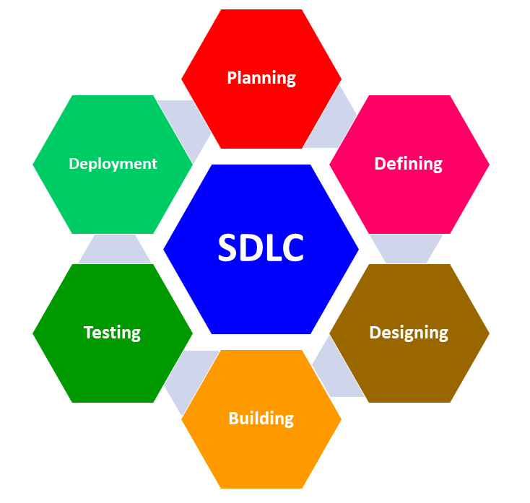
Software Development Paradigms

Slide 31
Which model can be selected if user is involved in all the phases of SDLC?
1
Waterfall Model
Prototyping Model
RAD Model
both Prototyping Model & RAD Model

Slide 32
Which model can be selected if user is involved in all the phases of SDLC?
1
Waterfall Model
Prototyping Model
RAD Model
both Prototyping Model & RAD Model
C
None

Slide 33
Which of these software activities are not a part of software processes?
2
Software Development
Software Dependence
Software Validation
Software Specification

Slide 34
Which of these software activities are not a part of software processes?
2
Software Development
Software Dependence
Software Validation
Software Specification
B
Software dependence is not a part of software processes .

Slide 35
What is the simplest model of software development paradigm?
3
Spiral Model
Agile Model
V Model
Waterfall Model

Slide 36
What is the simplest model of software development paradigm?
3
Spiral Model
Agile Model
V Model
Waterfall Model
D
Waterfall Model

Slide 37
Software consists of _____________________ ?
4
Set of instructions + Operating Procedures
Programs + Documentation + Operating Procedures
Programs + Hardware Manuals
Set of Programs

Slide 38
Software consists of _____________________ ?
4
Set of instructions + Operating Procedures
Programs + Documentation + Operating Procedures
Programs + Hardware Manuals
Set of Programs
B
Programs + Documentation + Operating Procedures

Slide 39
Software Project Management comprises of number of activities, which contains _____
5
Project Planning
Scope Management
Project Estimation
All Mentioned Above

Slide 40
Software Project Management comprises of number of activities, which contains _____
5
Project Planning
Scope Management
Project Estimation
All Mentioned Above
D
All Mentioned Above

